Slide 1
occupational therapy interventions with older adults
Demis Cachia
Senior AHCP(Occupational Therapist)

Slide 2
Who am I?
1996 graduated with a diploma in occupational therapy (4 year course)
2001 obtained a post-graduate diploma in geriatrics & gerontology (1 full year)
2005 finished European masters in occupational therapy (2 years course)
Clinical specialist in geriatrics in Malta
Specialised in Driving rehabilitation

Slide 3



Who am I?
Part-time lecturer at university of Malta (faculty of health sciences)
president of the MAOT
Delegate of cotec
Board member & treasurer of the Malta health network
Board member of the Malta federation of professional associations

Slide 4
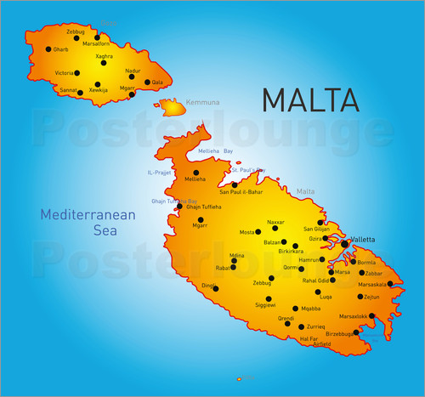
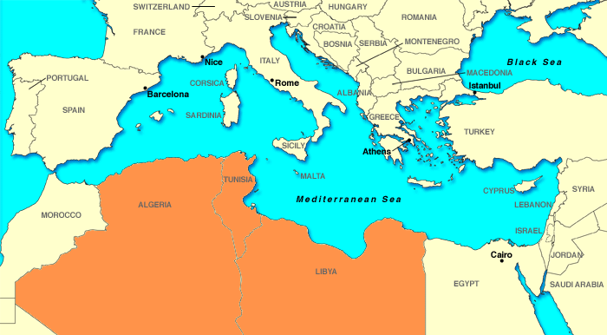
Malta
Size: 316 km2 in area
Current population: 431 thousand
Main economy is tourism
Health exp. 9.7% of GDP (World Bank)
Free Health Care System (Tax)

Slide 5

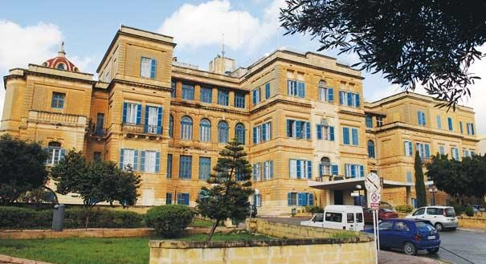
Why Geriatrics?

Slide 6
Demographical changes
We are an older population
  Increase life expectancy (by 2050 male: 76years; females: 85years)
  Better q.o.l.
  Decrease birth rate
  Decrease fertility rate
  Decrease mortality rate
Living longer does not necessary means living healthier.
Family Role in care giving – big change (increase pressure on health care systems).

Slide 7
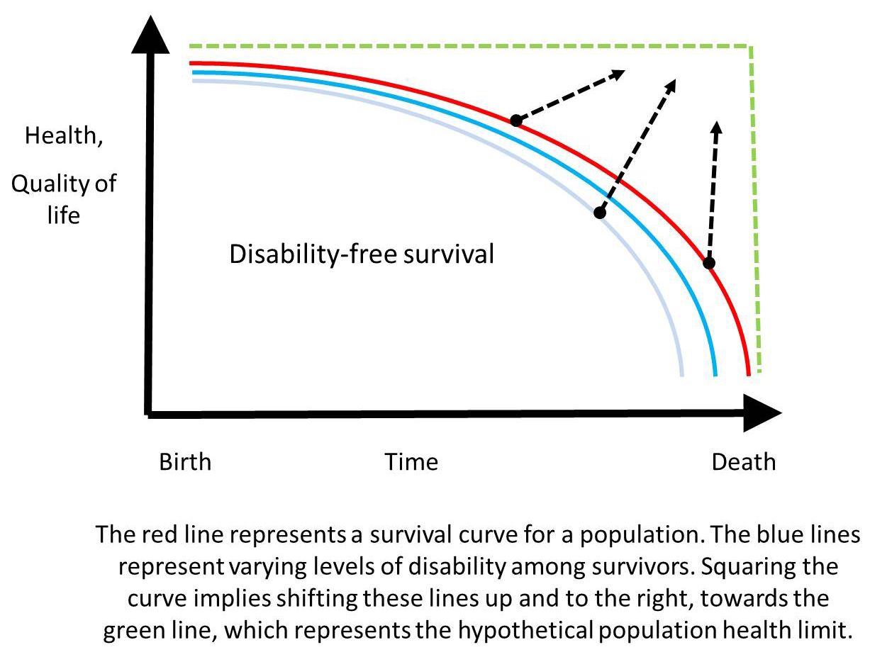
Squaring the mortality curve
Living longer healthier

Slide 8
Stereotypes associated with older persons
Less productive/ contribute less to society
Helpless and weak (physically & mentally)
All become demented
They don’t deserve health care
Being old means ill health
Loneliness
Older people want to die
Dependent on others
They live in institutions
Older people cannot learn
They have no feelings
They have No interesting relationship
Set in own ways/ rigid thinking
These lead to Ageism (negative attitude)

Slide 9
Geriatric giants
Prof. Bernard Isaacs (1965) highlighted the major illnesses associated with ageing.
  Immobility
  Incontinence
  Instability
  Intellectual disability (Delirium, Dementia, Depression)
  Iatrogenic (medication)
Today, we are speaking more about frailty, sarcopenia, the anorexia of ageing, cognitive impairment.

Slide 10
immobility
Impairment of the ability to move independently which result in limitation of life-space.
This limits independence, q.o.l. and its chronic.
causes:-
  Physical – weakness, stiffness, pain, balance, vision, oa, heart problems,
  Environmental – stairs, bed rails, lack of adequate aids.
  Psychological – depression, anxiety and fear.

Slide 11
complications
Pressure Sores | DVT
Muscle Atrophy | Constipation
Stiffness/ Contractures | Depression
OA | Demoralisation
Foot Drop | Nutrition Problems
Balance Problems | Institutionalisations
Postural Hypotension

Slide 12
Falls
An unexpected event in which the individuals comes to rest on ground.
Its a major event in once life
Causes
  Intrinsic
    Sensory – vision;
    Central processing – Dementia;
    Neuromuscular – Pd, gait;
    Musculoskeletal – arthritis)
  Extrinsic (furniture, obstacles, poor lighting, stairs, medication)
70% of falls occur at once house

Slide 13
Frailty
The state of being weak in health or body
Frailty is Commonly associated with aging
Usually older adults are weak having multiple medical problems, low independence, and impaired mental abilities.
Frailty is a state of vulnerability (decrease resistance to stressors)
Decrease reserve capacity (systems)
Risk factors (Geriatric Giants)
Needs team effort (complex)

Slide 14
Frailty
Frailty can be reversed
How
  Comprehensive Geriatric Assessment (Team intervention as early as possible).
  Physical exercise (Resistance, Aerobics, Flexibility and balance)
  Keep the mind active
  Nutrition (Balanced diet – protein, fruits, vegetables, fibre and fluids.
  Pharmacological intervention (Hormonal, Vitamin D)
  advantage – Managing frailty http://advantageja.eu

Slide 15
Chronic disease
Chronic diseases in Europe affects 2/3 of population above 65 years.
Chronic disease increase pressure on health care systems finances.
European patient forum has conducted a 2 year study entitled, “pro-step project” on promoting self-management for chronic disease Europe. Main outcome
  1. health literacy/ education
  2. Health care professional needs to be better equipped in supporting patients.
  3. resources and systems need to support self-management.

Slide 16
Chronic disease management
The centres for disease control estimates chronic disease limits adl’s and participation in community related activities (bondoc & siebert, 2013).
Self-management is recognised is an effective approach to manage chronic health conditions (national institute of Health, 2010).
Self-management is about being in charge of one’s life and managing own condition.
Occupational therapists can help to:-
    Help develop strategies to incorporate energy conservation techniques (decrease fatigue)
    Modify activity and pacing
    Lifestyle Adaptations

Slide 17
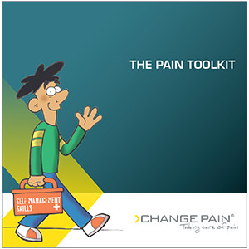
Self-management programme
Pain toolkit
Developed by pete moore
Self-management book
Translated to many languages
www.paintoolkit.org

Slide 18
WHO 10 priorities Healthy Ageing
Build a platform for innovation and change
Support country planning and action
Collect better data on healthy ageing
Promote research that addresses the needs of older people
Align health systems to the needs of older people
Lay the foundations for a LTC system is every country
Ensure the human resources necessary for integrated care
Undertake a global campaign to combat ageism
Make the economic case for investment in healthy ageing
Develop the global network for age-friendly cities and communities

Slide 19
What can be done
“knowing is not enough; we must apply
Willing is not enough; we must do”
goethe

Slide 20
rehabilitation
Various definitions.
The restoration of the individual to the optimal level of ability, within the needs and desires of the individual and his or her family (K. Andrews, 1987).
GERIATRICS IS CONCERNED WITH THE CLINICAL, PREVENTIVE, REMEDIAL AND SOCiaL ASPECTS OF THE ILLNESS OF THE OLDER PEOPLE.

Slide 21
Key words in Rehabilitation
Complex processes
Several disciplines are involved
Restoration
Concentrates on improving function
Concentrates on improving Q.O.L.
aim for optimal levels possible
Reintegration into society
Return home
What does the client wants?
Individualised
What do the carers feels?

Slide 22

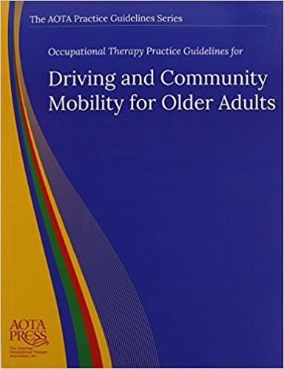

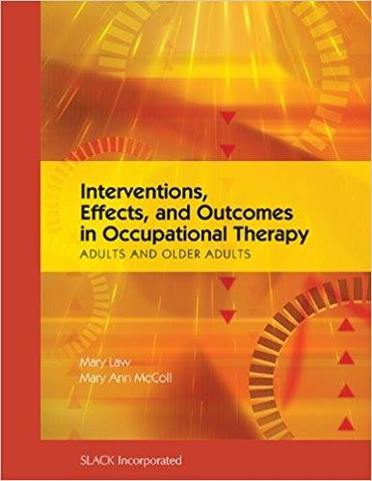
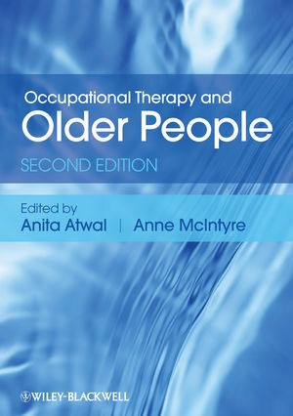

OT knowledge at least 28 books focuses on older adults

Slide 23
Occupational Therapy interventions
Comprehensive O.T assessment
Functional Activities
ADL Re-training
Prescription of therapeutic equipment
Wheelchair and seating clinic
Splinting
Home visits/ instrumental Home visits
Family training sessions
Group therapy intervention
Driving assessment
Health promotion and awareness.
Community services

Slide 24
Assessments
Comprehensive physical, cognitive, functional, social, sensory, and psychological assessment.
It must be multidimensional by an interdisciplinary team.
Very important to know pre-morbid lifestyle of person (contact family if need be).
Holistic view of the patient important.
Part of Inter-professional clinical documentation (easy access and communication).
Documentation is soon going to be paperless.
As a profession in Malta we are using cmop-e (modification of home made assessments was done) to ensure client/family centred approach.
Assessment is important to set up goals with patient/family and to formulate a treatment plan.
Assessment should be ongoing and goals should be modified accordingly.

Slide 25
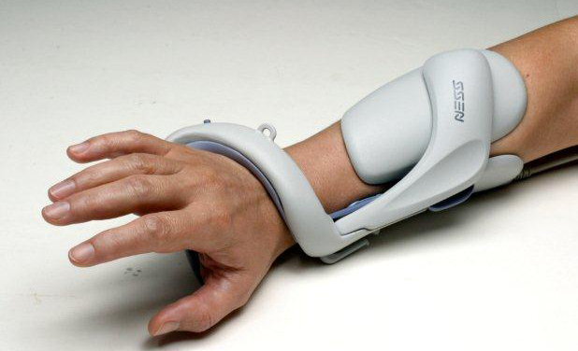
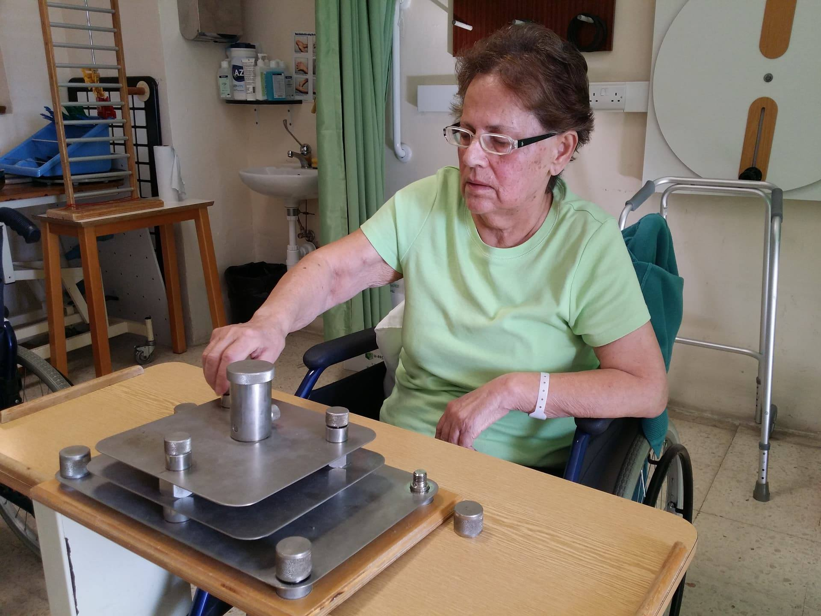
Functional Activities
Functional activities should transfer into function
Activity that is personally meaningful and contextually anchored with older peoples’ everyday lives has the greatest ability to enhance health related outcome (Hay et al.,2002.)
Are we being functional?
What image we want to give?
New technologies used as Bioness and Functional Electrical Stimulation (FES) are we deviating from our roots.

Slide 26
ADL’s Retraining
Unique of occupational therapists.
  We should feel proud. “OT is the only profession with explicitly
  focused training on participation in everyday life” (clark, 2011).
Its not easy as one think (often taken for grated).
Various approaches can be used.
Personal self-care: bathing, dressing, toileting, feeding, grooming, functional mobility.
Instrumental self-care: shopping, driving, community mobility, use telephone, housework, home repair, cooking, laundry, medications, finances.
Tools used: Katz index, Amps, barthel, lawton scale, vulnerable elders scale etc

Slide 27
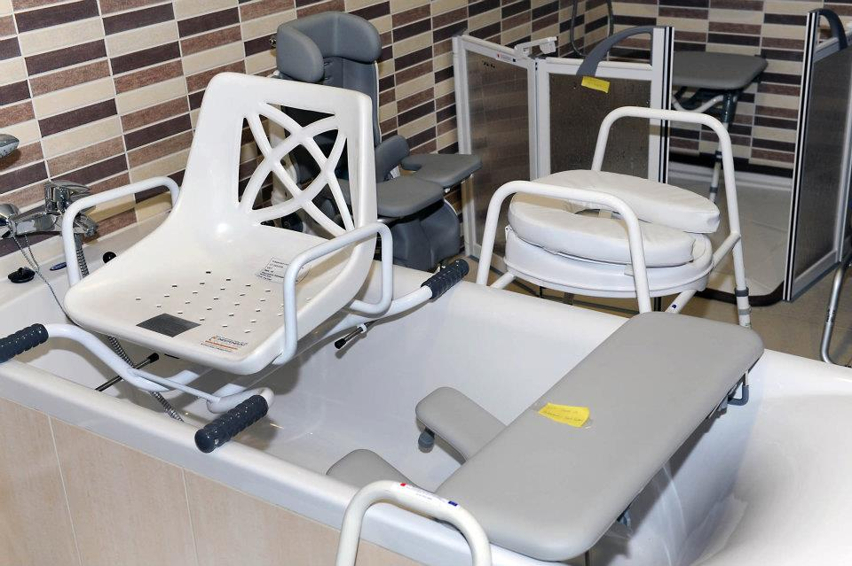
Prescription of Equipment
Main aim to encourage independence or to minimise stress on family
Equipment for self-care example Feeding, Toileting, dressing, bathing and toileting.
Home equipment examples bathroom, bedroom and kitchen.
Car modifications important for community independence.
Assist patient and family in filling the necessary forms for financial support.

Slide 28
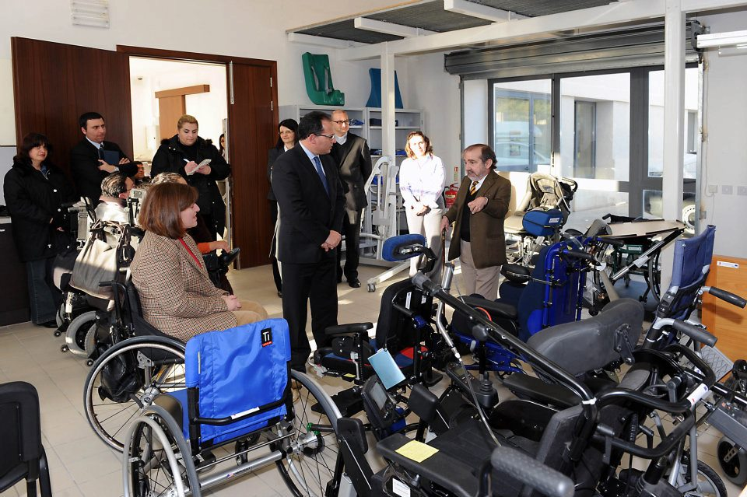
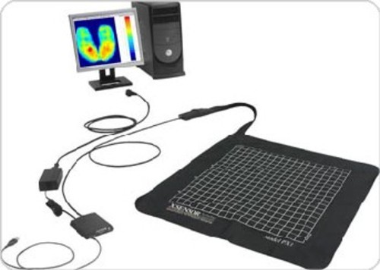
Wheelchair and seating clinic

Slide 29
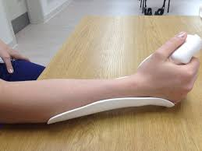
Splinting
To correct and prevent deformities
Improve function
Prevent or relieve pain

Slide 30
Home visits
When is best to carry out a HV?
For what? (explain the patient and relatives why)
Important to give a report of the visit to patient and family highlighting modifications required.
Give a time frame before discharge (planning is crucial)
Ideally a Team approach .
Alterations to improve access.
Structural home alterations.
Practical changes in the home layout.
Furniture adaptations.
Safety advice.
Practice basic home tasks.

Slide 31
Instrumental Home visits
Observing patient practicing a number of functional tasks in their home and neighbourhood.
Observe safety and one coping skills/ strategies.
Fact: A single home visit by an occupational therapist at a median of 20 days after discharge significantly reduced the proportion of fallers from 26% to 8.8% (Di Monaco et al.,2008)

Slide 32
Family training sessions (FTS)
Done by the Occupational Therapist, Physiotherapist and Social worker.
Formal discussion about rehab outcomes.
Strengths and weakness of the patients are demonstrated.
Practical advise is given.
Relatives can practise a number of skills.
Relatives and patients can voice there concerns.
Timing of FTS is crucial.

Slide 33
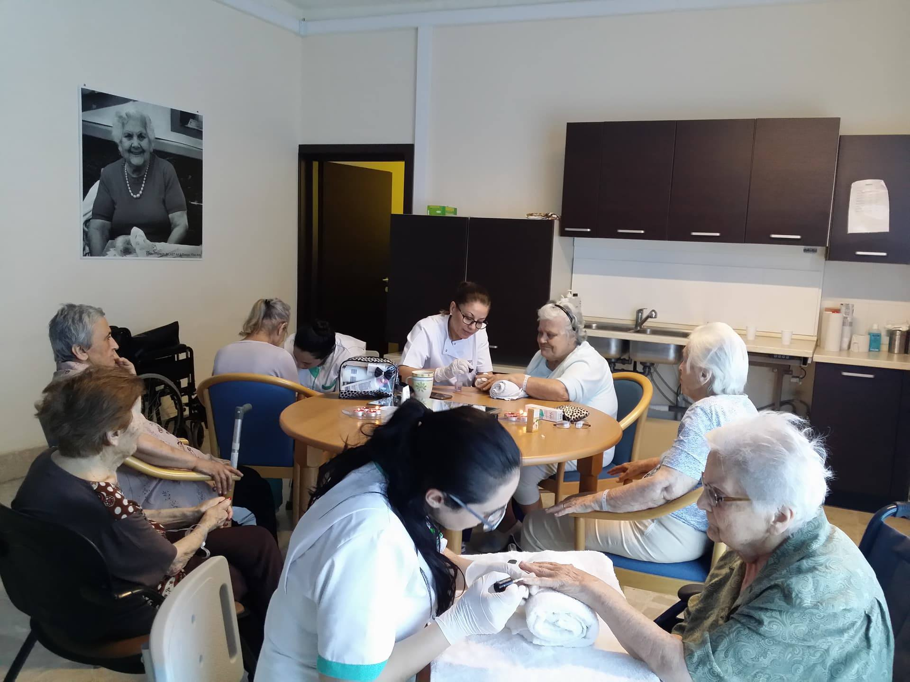
Group therapy interventions
Different groups have different aims.
Group therapy improves socialisation skills.
Is comforting to hear that other people have similar difficulties (most of NGO’s are formed on this notion).
Some might feel more open to express their feelings.
group members learn from each other.
Encourage competitiveness.
Give support to each other.

Slide 34
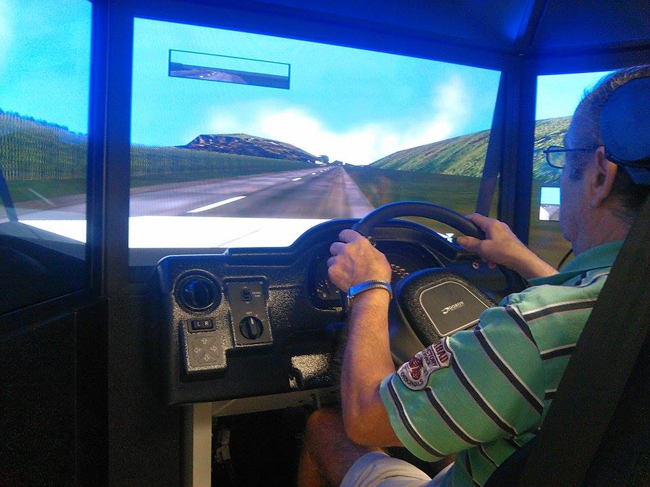
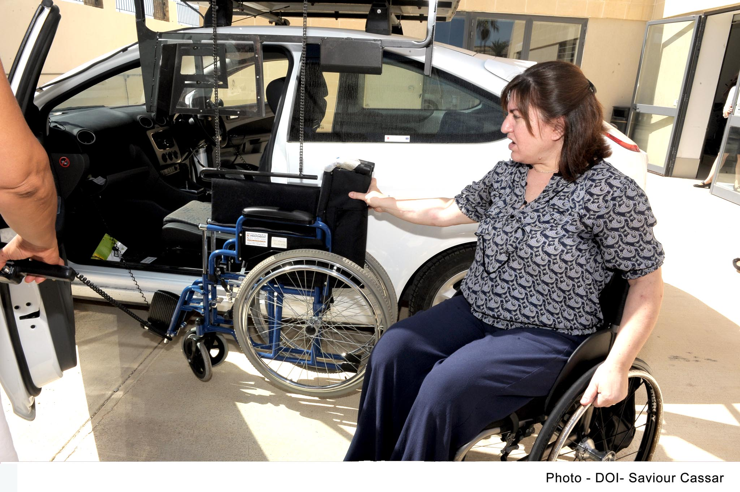
Driving assessment
Independent living centre
physical, cognitive and vision assessment is carried out.
New strategies, advices on adaptive devices or car modification.
Driving can preserve social engagement and active lifestyle.
Scooter assessments (alternative).

Slide 35
Health promotion and awareness
Occupational therapy has a preventive role-activity. It is viewed as a critical element to promote longevity and healthy lifestyles (Gitlin, 2011).
Examples:
  Stroke awareness
  Falls awareness
  Workplace prevention
  Education – caregivers
  Stress & anger management

Slide 36
Community services
Commcare assessment unit
Telecare
Day centres
Residential homes
Night shelter
Handyman
Incontinence
Housing schemes
Agenzija support
Meals on wheels
Home help
Minimum standards for care homes for older people
Charter of rights for residents living in care homes for the elderly
Life long learning hubs
Beactive – active ageing project

Slide 37

Commcare assessment unit
Team approach within the community.
Team includes nurse, ot, pt, sw, personal carers and administrative staff.
Main scope is to ensure older persons remains in their own house.
They carry out assessments via the phone and home visits and set-up goals with patient and family.
Outreach team – continuation of rehab at patient home.

Slide 38
Active ageing centres
21active ageing centres spread around Malta and gozo
These centres offer opportunity for older adults to remain physically, mentally and socially active.
Programme includes activities such as educational talks, outings, games (sports day competition) but also lifelong learning opportunities including computer courses, crafts lessons, dancing classes, first aid courses and cultural visits.

Slide 39
Dementia
Dementia is a decline in mental ability that usually progresses slowly, in which memory, thinking and judgment are impaired.
It is one of the most important causes of disability in elderly.
The most common forms of dementia are Alzheimer's (around 50-60% of cases), and multi-infarct dementia(30%). Others including Pick’s disease and lewy-body dementia.
In Malta it is estimated that around 4,300 people suffers from dementia (1.26%).
In Slovenia percentage is a bit higher 1.57% (EU average 1.55%)
No cure in dementia – drug treatment help to treat some of the symptoms.

Slide 40
National Dementia Strategy
Empowering change (2015)
Aim is to enhance the quality of life of individuals with dementia, their caregivers and family members through the implementation of a number of interventions :-
  Increase awareness and understanding of dementia (educate general public)
    Recognise early symptoms and to seek advice (early diagnosis)
    Decrease stigma and fear
  Develop dementia-friendly communities
  Training to healthcare professionals
  Dementia Research as a national priority

Slide 41
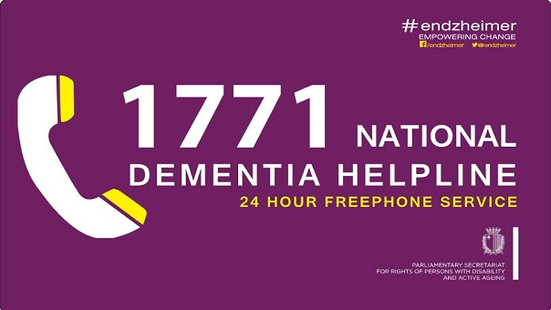
Community Services
  Dementia intervention team
  Dementia Activity Centre

Slide 42
  Dementia intervention team
Developed as part of the national strategy.
Its under the department of rights of people with disability and active ageing.
Team is composed of a coordinator, nurse, a psychologist, an occupational therapists and a social worker.
Community based service (outreach service).
person-centred care approach towards persons with dementia & their caregivers.
Service aimed to provide education, advice and support via professional expertise.
It’s a self-referral by a phone call or referral via GP or health professional

Slide 43
  Dementia Activity Centre
This helps to reduce caregivers stress (respite service) whilst providing therapy for person with dementia.
These centres provide a safe, secure and dementia-friendly environment.
Activities includes crafts, music and games.
Very often 1-1 intervention is required.
Free of charge.
Centre is located within long-term facility that provide easy access to medical team (if required immediate care)

Slide 44
Occupational Therapy intervention
RHKG dementia clinic – patients are referred by consultants
General Assessment
  CMOP-E/ Home based assessment (as part ICpD)
  Specific for dementia –
    The Rowland University Dementia Assessment scale (RUDAS)
    Cognitive assessment of Minnesota (CAM)
    Cognitive assessment (home made)
    Intervention (mostly individual and based according to patient and family needs)

Slide 45
Memory Class
We provide 2 Class – Mild/ moderate and Advanced class.
Team approach (OT, PT, SLP, SW, Nurse, pharmacist, Consultant, Psychiatrist)
coordinated by the Occupational Therapist
A re-assessment by OT and SLP is done a few weeks before start of the class
Aim for the mild/ moderate impairment
  provide support (by staff and between participants)
  give them knowledge about the condition and how to deal with new situations/ difficulties
  Criteria MMSE not less 10 and living in community
  12 sessions (around1.30hr)
  Maximum number of participants: 12 patients
Aim of advanced class
  To give support family
  patients will be engage in activities/ participation
  Maximum participants 6 patients

Slide 46
Programme
(mild-moderate) day and time of the class is kept same
Day 1:
  Clients: introducing themselves and ice-breaking games.
  Relatives: session on nursing care and role of the nurse.
Day 2:
  Clients: R.O. crossword followed by physical exercises.
  Relatives: Session with geriatric consultant.
Day 3:
  Clients: session focused on communication, expression & language.
  Relatives: Importance on mobility & exercise.
Day 4:
  Clients: ADL’s participation
  Relatives: medication/ pharmacology

Slide 47
Programme
Day 5:
  Community visit
  (cultural/ educational outing)
Day 6:
  Clients: Domestic session
  Relatives: Psychiatric & Psychological importance
Day 7:
  Clients: Creative activity
  Relatives: Self-care and independence
Day 8:
  Clients: Relaxation session (stretching and meditation)
  Relatives: Communication skills

Slide 48
Programme
Day 9:
  Clients: Creative story
  Relatives: Dysphasia & swallowing session
Day 10:
  Clients: Memory box & reminiscence
  Relatives: Behaviour management
Day 11:
  Clients: Gardening session
  Relatives: Social worker intervention
Day 12:
  Evaluation and get together
  Distribution of certificates

Slide 49
Programme - Advanced class
Since patients in the advanced class will have severe cognitive and physical decline, they will be encouraged to participate in varied leisure activities such as crafts, gardening and domestic tasks.
On The other hand, caregivers will meet the Memory class team to discuss several issues including how to manage behaviour, coping with daily life issues, mobility advice, nutrition, communication, swallowing and home safety.

Slide 50
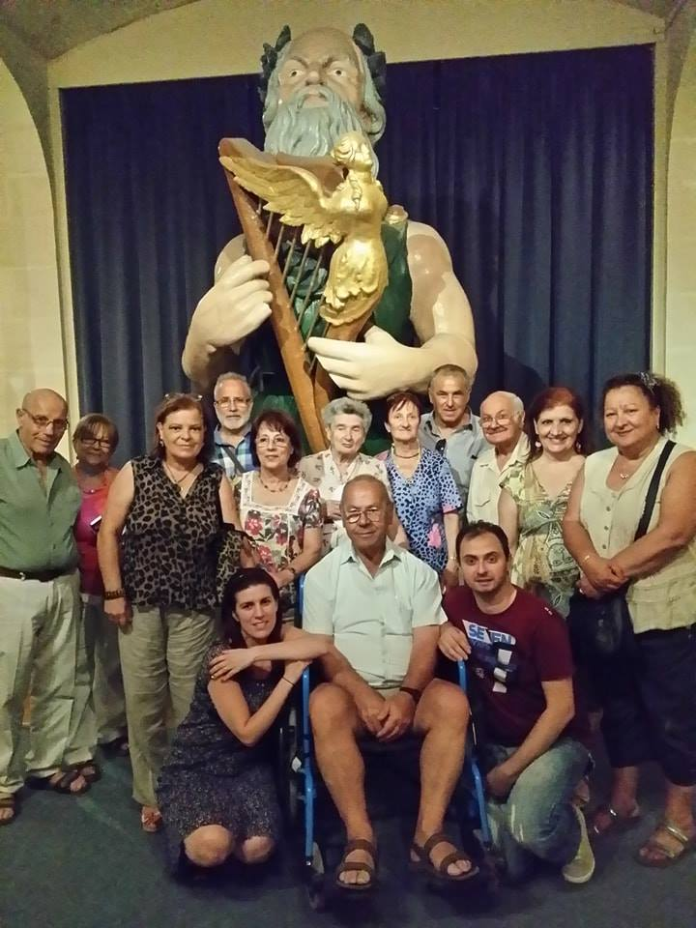
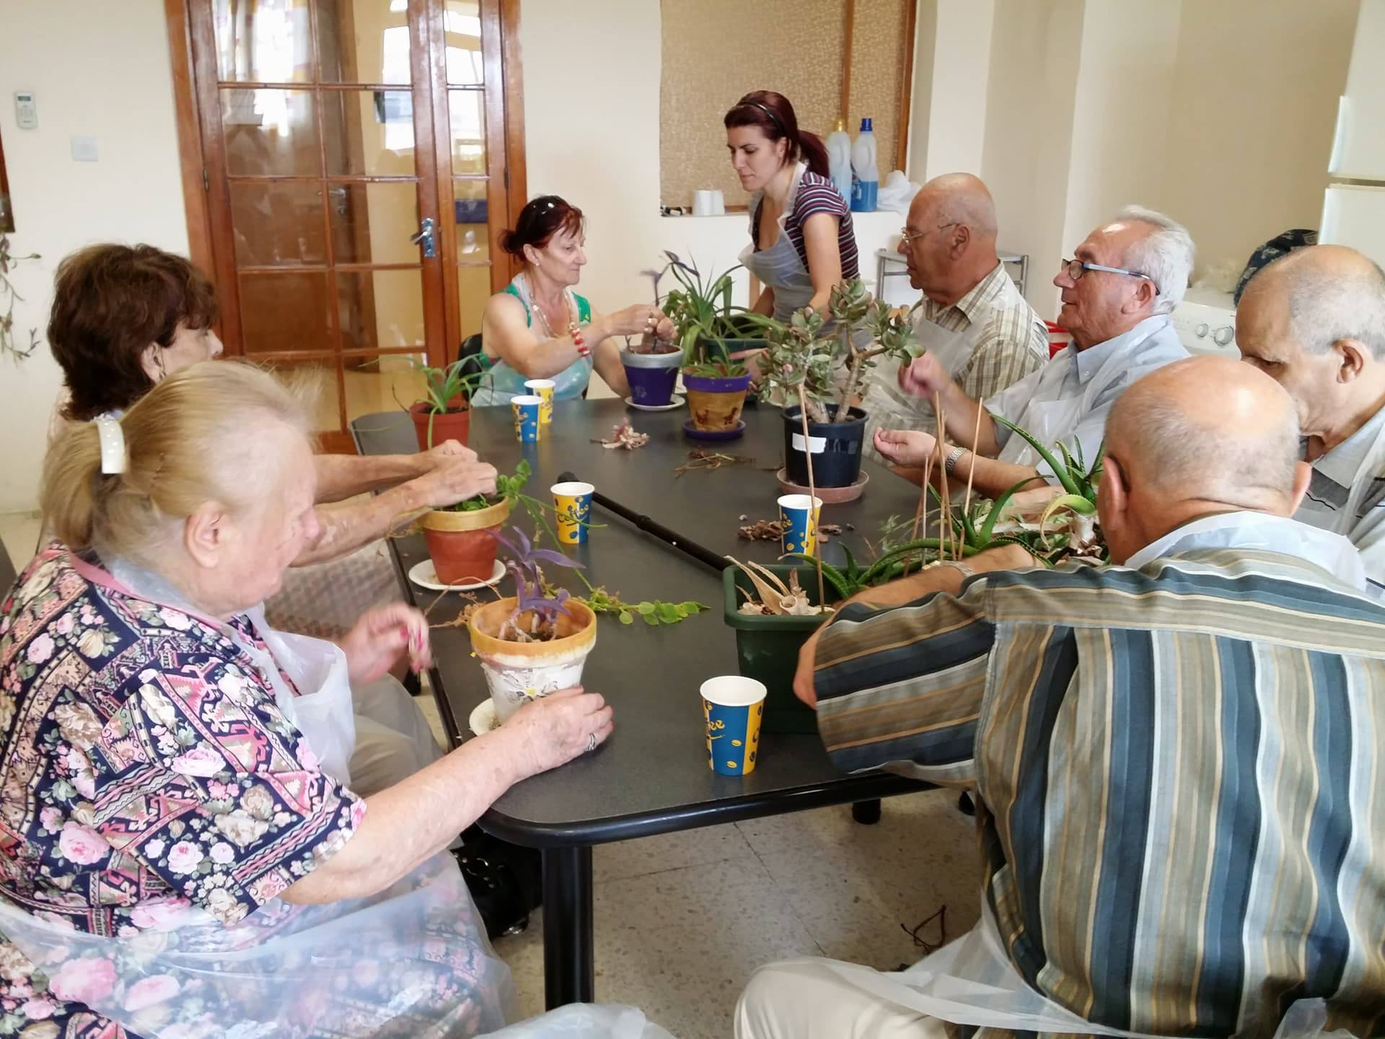

Slide 51
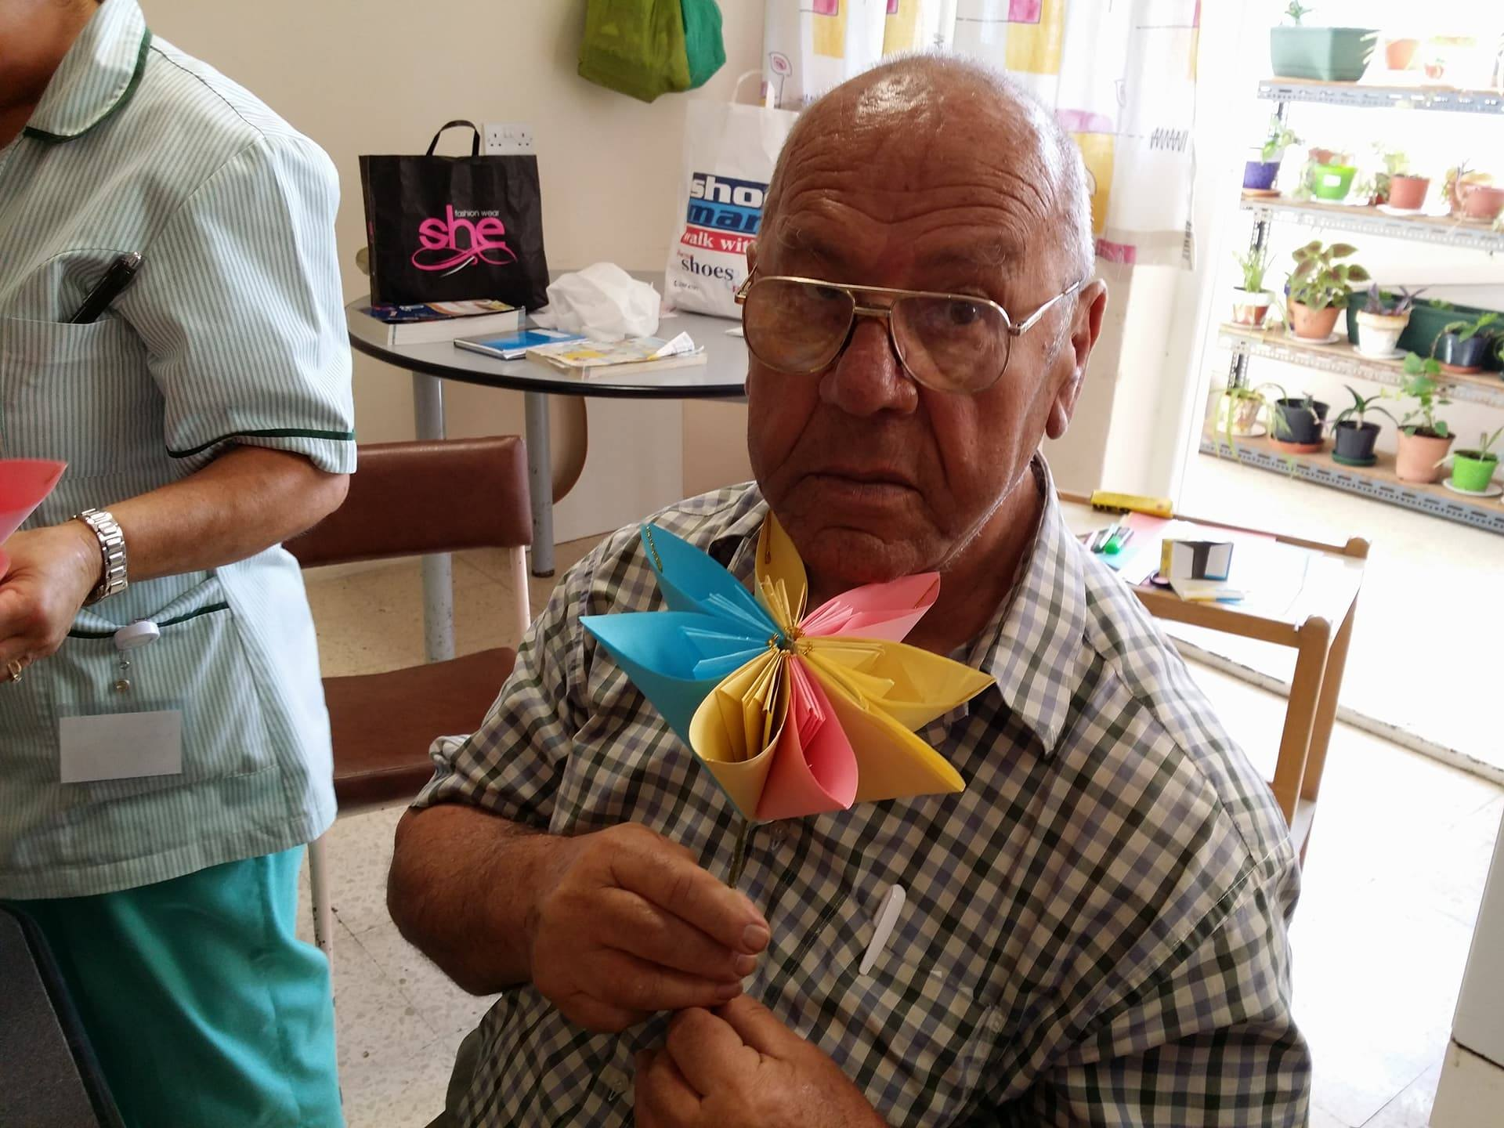
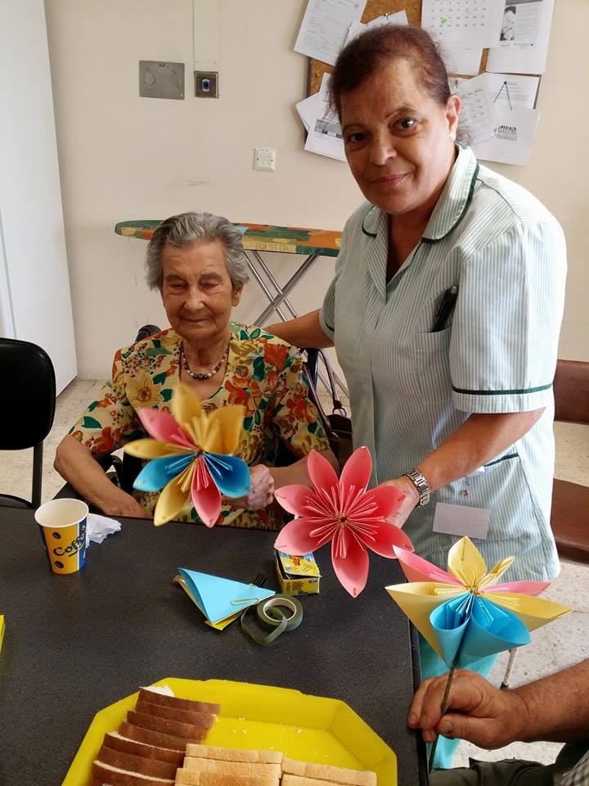

Slide 52
conclusion
We have an important role to play.
we have to be Client centred and empower our patients and their relatives.
We have to be innovative – yet we have to keep to our roots (challenge).
We have to be positive

Slide 53
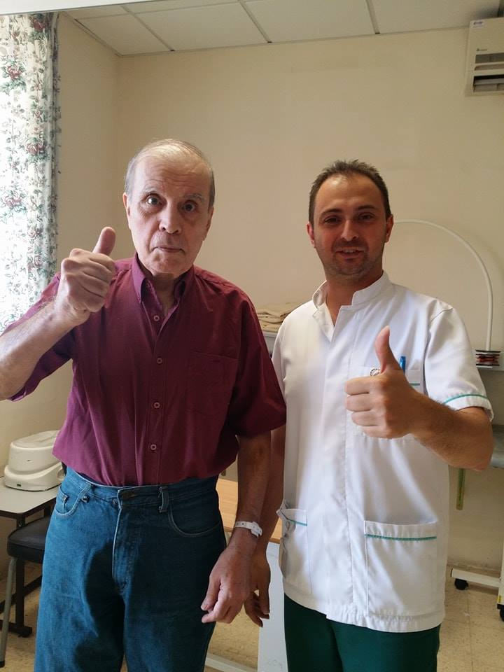
Thank you

